Slide 1
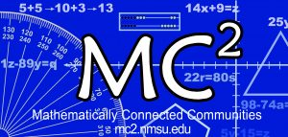
Mathematically Connected Communities
This session will be recorded and available at https://mc2.nmsu.edu/
Welcome! Please introduce yourself in the chat box by writing your name, your district, and your role in the education sector.
Structuring Accelerated Learning in Reentry
September 23, 2020
5:00-6:00 pm
Notes:
Allie Slides 1-4
5:00-5:20

Slide 2
Check In
What’s the last movie you watched/show you binge-watched?
What have you learned about yourself and others in quarantine?
What are you leaving behind from your pre-CoronaVirus life?
Notes:
Offerings of Sentence Starters/Icebreakers
Breakout Rooms for 7 minutes
What’s the last movie you watched/show you binge-watched?
What have you learned about yourself and others in quarantine?
What are you leaving behind from your pre-CoronaVirus life?

Slide 3
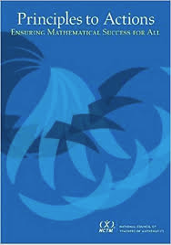
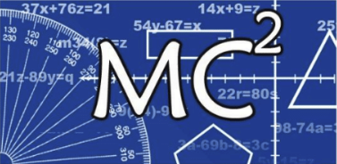
Mathematically Connected Communities (MC²) works to improve math education through a variety of professional learning experiences which align to the New Mexico Public Education Department’s (NM PED) reentry guidance.
Four Live Web-Events Sessions
Awareness and Information: Purposeful Reentry and Adapting to Change
Unpacking Important Mathematics Reentry Documents
Structuring Accelerated Learning in Reentry
The Importance of Models in Developing Fluency
Notes:
Summary of what we have don, the path we have been on.
e
Where are there joyful places?

Slide 4
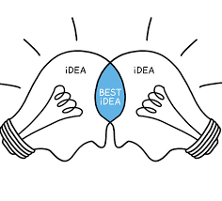
Norm Offerings for our Collaborative Session
In exploring today, what are the norm(s) you will take with you?
Invite participation by using names
Honor individual thinking and learning time
Ask questions
Expect to share
Reflect on where you want to grow
Other?
Notes:
Allie Slides 1-4
5:00-5:15

Slide 5
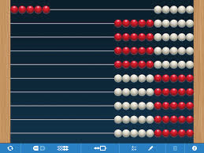
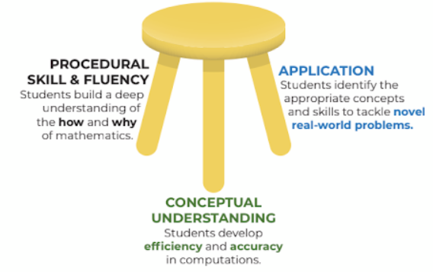
Session Goal: Why Models and Fluency?
9 + 6…
9, 10-11-12-13-14-15
“…the most commonly observed characteristic of low attaining math students is a persistent dependence on counting by ones.”
-Wright et. al., 2012
Notes:
Michelle
5:15
Here is a model we looked at last time.
This model is conceptual and procedural.
Grounded in a model I can use by myself to build knowledge
Reentry: models give kids the opportunity to see/make sense of connections and create opportunity to discourse in mathematics
What do you think?
What does the research say?
In accelerated year,
Not relying on counting by ones, ELEM
Splitting and Unitizing, MS-HS
What does it mean to split? What does it mean to iterate?
What does it mean to be a unit beyond one?

Slide 6
“…the most commonly observed characteristic of low attaining math students is a persistent dependence on counting by ones.”
-Wright et. al., 2012
9 + 6…
9, 10-11-12-13-14-15
Notes:
The part that is problematic is that students do not develop more sophisticated understandings of numbers than that they are composed of units of one.
Relate this research back to the last time. (Elementary)
Now what does that mean for our older students?
Splitting.

Slide 7
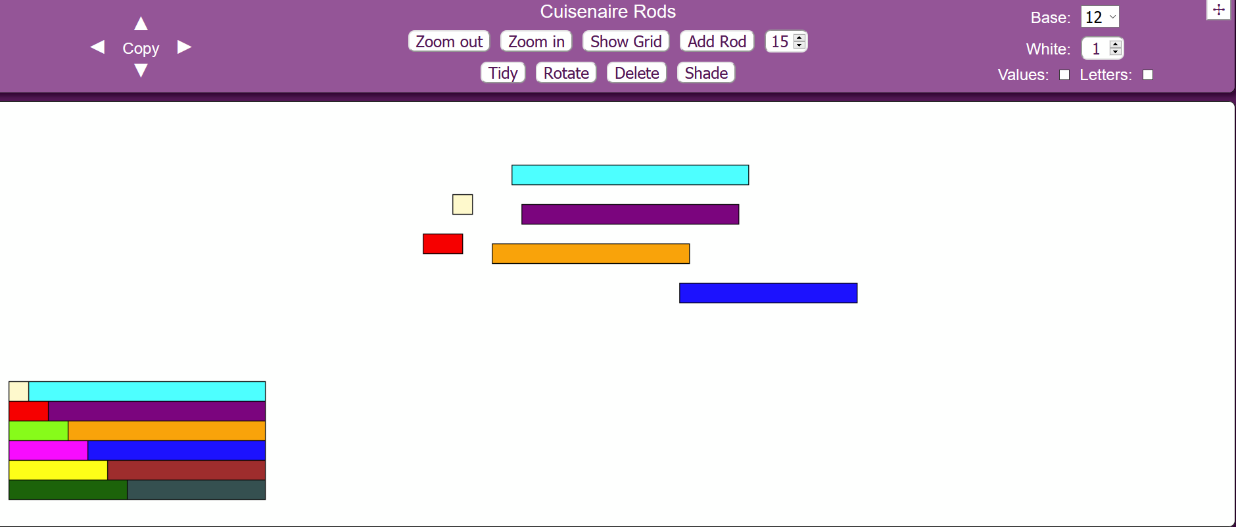
Guess My Fraction
Cuisenaire Rods
Notes:
5:20-5:40 Erika
https://mathsbot.com/manipulatives/rods
Introduce and go to breakout rooms!

Slide 8
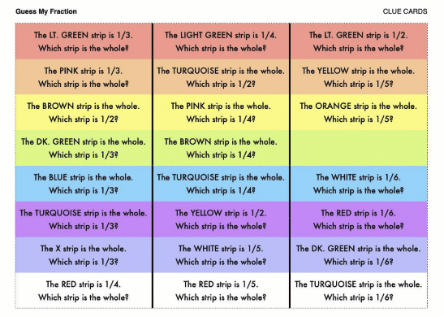
Let’s play with the tool first! Explore the settings. What noticings do you have? What are some tasks your students could engage in?
In the upper right corner of the webpage, adjust the base to 12.
Put one of each color in your workspace. You will have 12 bars. Do not add additional bars to your set. Use your set of cuisenaire rods to solve the task.
Let’s look at 1 or 2 of the rows of the Guess My Fraction clue card and the cuisenaire rods to explore it.
Notes:
The red row is an entry point/invitation.
As the rows move down, it becomes more challenging.
What do you observe about your own thinking strategies and the feelings that come as you navigate through this mathematics?
5:40 - 5:43 Michelle (Chat and Verbal) - After Breakout Rooms
sentence frame in your head
Connect 4th-8th grade
Where did you unitize?
Where did you split?
Where did you iterate? What did you have to hold on to?
I unitized when I…
I split when I…
I iterated a unit when…

Slide 9
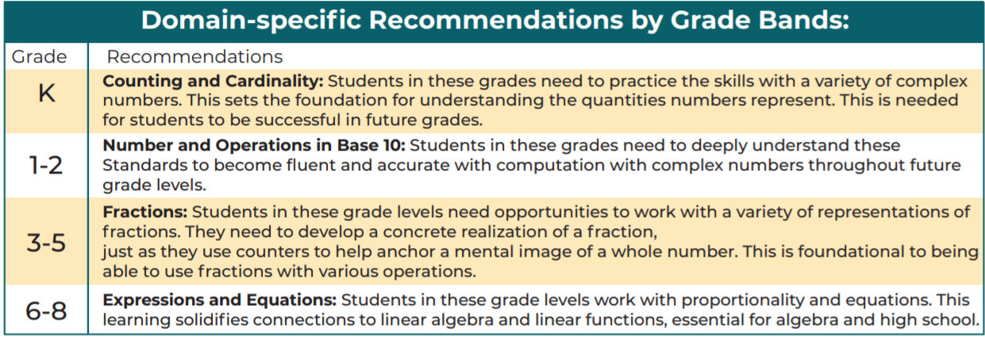
Fluency
When Mathematical skills grow from conceptual understanding, students can use the relational knowledge in application and computation.
Notes:
Michelle Done 5:45 Talk at connection - link back to 3 footed stool picture.
The mathematics does not live in the strategy, the mathematics lives in the child…
This is what the research said, 8th graders able to do this math was in the single digits.
Middle and high school teachers, thumbs up if you feel this!
The proportion is relationship between two ratios---it is the abstract.
HERE IS THE ARTICLE: Link
Full Circle: Splitting and Unitizing cannot occur without Structuring Number knowledge, 6-8 standards learning in priority docs can’t happen without splitting and unitizing ----so we engage in thoughtful Acceleration and ReEntry when we give student repeared experiences so that the strategies will live in them. Giving children models that they live with and carry around with them is one of the best servies we can provide as mathematics teachers. A tool from which to build mathematical understanding over and over again as life calls for it.

Slide 10
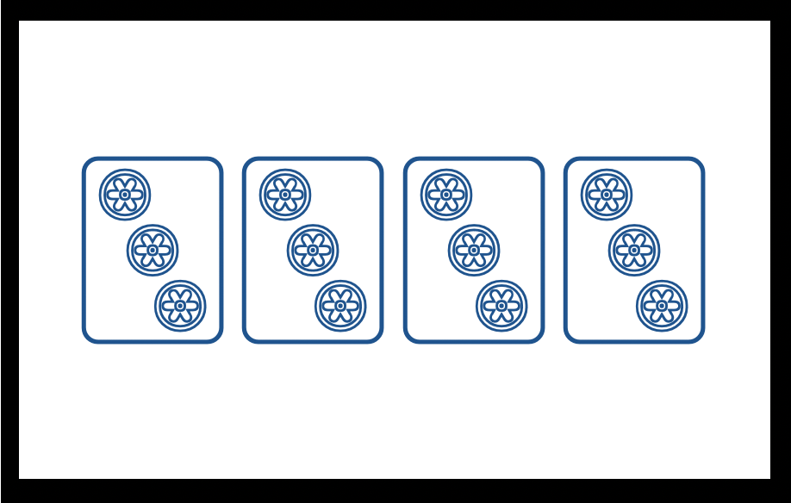
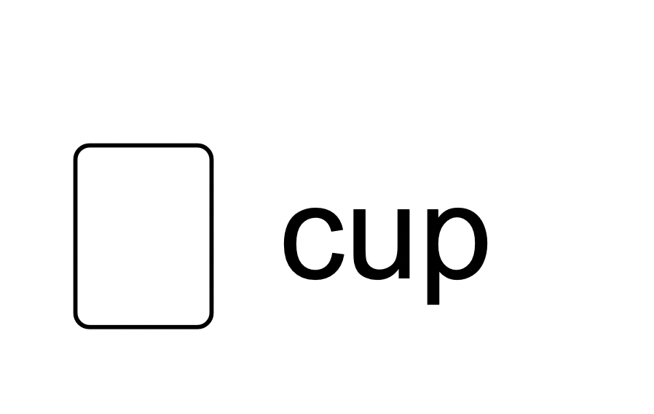
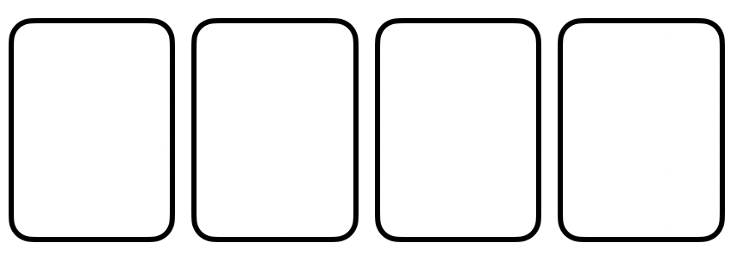
2 ¢
Discussion Card
3
chips
4
cups
Support Card:
cups in a box
Support Card:
chips in a cup
? ¢
Notes:
Allie 5:45-5:55
What would a more advanced number talk look like with models?
We are getting an experience of what it feels like to split and unitize. How do we recognize when we’re asking children to do this, how do the models support our learning?
Completed TASK SLIDE (example)
Set up the task: Label each item’s value for the task; include the question for the task as one of the labels. Place the discussion card and the support cards for the task under their covers.
Present the task: “A chip is worth 2¢. A cup has 3 chips. A box has 4 cups. How much is a box worth?”
During the task: Students may ask to see one of the Support Cards.
To move the cover behind the card: Select the Support Card, then in the menu bar choose Arrange → Order → Send to back
After students solve the task: When discussing solutions, show the discussion card so that students can refer to it as they explain how they got their answers.

Slide 11
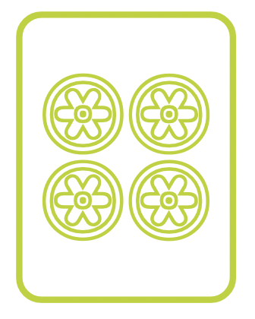
4 ¢
Discussion Card
4
chips
?
cups
64 ¢
Support Card:
cups in a box
Support Card:
chips in a cup
Notes:
TASK SLIDE (master)
Duplicate this page to make setups for each task you want to present in your lesson.
To move Support and Discussion Cards behind the screens:
Arrange → Order → Send to back

Slide 12
Reflect: What do you know now that you would share with a colleague? What have you learned that excites you about planning for students’ mathematics learning?
Notes:
5:55 - 6:00 Ask to put into the chat.

Slide 13
Thank you!
Thank you for being a part of this Purposeful ReEntry Community!
Thank you for all you do for children and the larger community through your work.
Keep on swimming!
Link to MC² Website:
https://mc2.nmsu.edu/
Link to MC² Professional Learning Webpage: https://mc2.nmsu.edu/pd/
Link to MC² Contact Page: https://mc2.nmsu.edu/about-us/contact-us/

